Slide 1


CRYPTOMANIACS
Goa Institute of Management
Presenters:
Himanshi Swaroop
Prachi Gopalani
Shivani Singh

Slide 2


Problem Statement:
Predict top 10 stocks across the entire US market (NYSE, NASDAQ, etc.) automated each week using the daily stock market data as the base data.
Predict their stock prices for upcoming week.

Slide 3







Road Map
Data Extraction
Data Preprocessing
Exploratory Data Analysis
Model Building
& Training
Model Selection
FrontEnd
App
Sentiment Analysis
Forecasting Stock Prices
Report Documentation

Slide 4





Tools : Anaconda Navigator (Notebook), Spyder, Jupyter
Language: Python
Webpack Configuration : JSON
Web Framework : Streamlit
FrontEnd: HTML, CSS, Streamlit

Slide 5
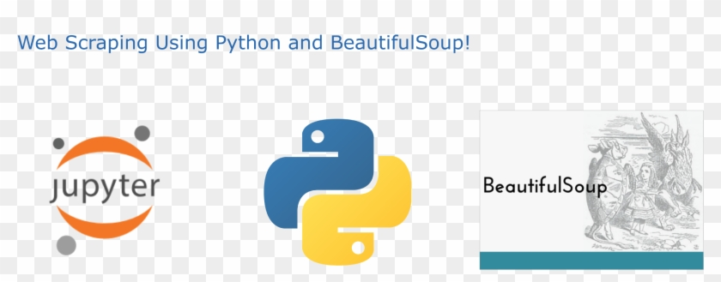


DATA EXTRACTION

Slide 6

Methodology Flowchart

Slide 7
Fetch Data from Yahoo Finance (Index: S&P500)
Calculate return of each company relative to market
START
Checking Minervini Condition for top 10% Stocks
Selection of Top 10 Percentile companies
Sorting companies w.r.t highest return relative to market
Selecting Top 50 Companies from above List
Check some short-term conditions among 50 companies
Select& Displayed Top 10 Companies
Predict Price for Next week
LSTM Model Implementation
END

Slide 8

Selection of Top 10 Company Stocks

Slide 9



Calculating Return w.r.t market index
% Change of closing price
Calculate stock return
Calculate ratio of return w.r.t market index return.

Slide 10
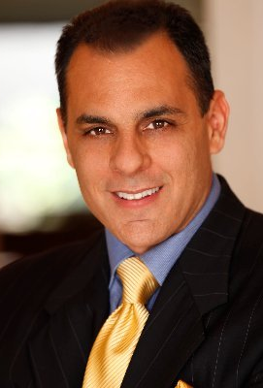
About Mark Minervini
He is considered one of America's most successful stock traders
A veteran of Wall Street for more than 35 years.
He is the author of the best-selling books Trade Like a Stock Market Wizard and Think and Trade Like a Champion.
Starting with only a few thousand dollars, Mark turned his personal trading account into millions, averaging 220% per year for more than five consecutive years with only one losing quarter; an incredible 33,500% total return. To put that in perspective, a $10,000 account would explode to more than $3 million in just 5 years.

Slide 11

In Mark’s first book: Trade Like A Stock Market Wizard he published his Trend Template.
He uses that to filter out stocks using some technical criteria before doing an additional research on them.
“The Trend Template is a qualifier. If a stock doesn’t meet the Trend Template criteria, I don’t consider it. Even if the fundamentals are compelling, the stock must be in a long-term uptrend—as defined by the Trend Template—for me to consider it as a candidate.”

Slide 12

The Minervini Principles
The current closing price of the security must be greater than the 150 and 200-day simple moving averages of closing price.
The 150-day simple moving average of closing price must be greater than the 200-day simple moving average of closing price.
The 200-day simple moving average of closing price must be trending up for at least 1 month.
The 50-day simple moving average of closing price must be greater than the 150 simple moving average and the 200 simple moving average of closing price.
The current closing price must be greater than the 50-day simple moving average of closing price.

Slide 13

Model Building and Training

Slide 14
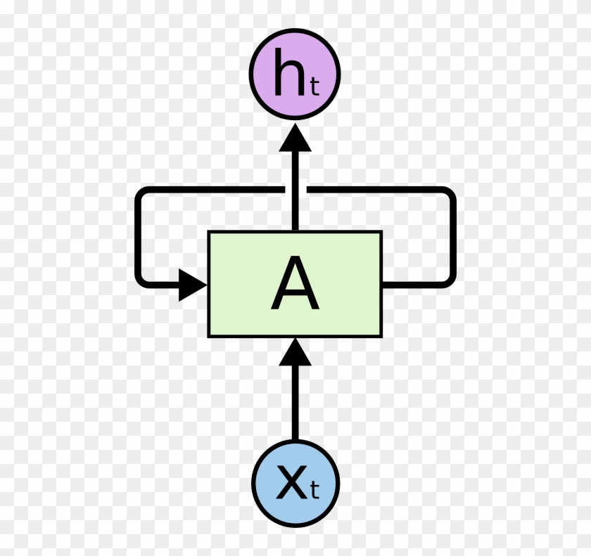
LSTM MODEL
Libraries: Numpy, Pandas
No. of epochs: 20
Packages Used: yahoo_fin, sklearn, keras, tensorflow
Optimizer: Adam
Visualizations: matplotlib
Scaling: MinMaxScaler ()
MSE: 0.0225

Slide 15
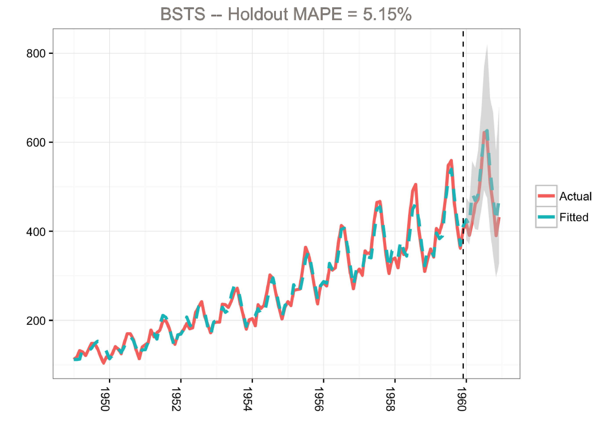
ARIMA MODEL
Libraries: Numpy, Pandas, ARIMA
Packages Used: statsmodels
Visualizations: matplotlib
Scaling: MinMaxScaler ()
MSE: 1.686

Slide 16

Why LSTM FOR STOCK PREDICTION?
LSTMs are very powerful in sequence prediction problems because they’re able to store past information. This is important in our case because the previous price of a stock is crucial in predicting its future price.
LSTM has an advantage over traditional neural networks due to its capability to process the entire sequence of data.
Capable of analysing and exploiting the interactions and patterns existing in data through a self-learning process
Makes good predictions because it analyses the interactions and hidden patterns within the data
Good in remembering information for long time

Slide 17


ARIMA & SARIMA models are regression-based approaches to the problem, they are hardly able to model data with nonlinear relationships between parameters.
There are some assumptions about data when conducting statistical tests that need to be held in order to have a meaningful model (e.g., constant standard deviation).

Slide 18

ARIMA Limitations
Does not work well for nonlinear time series
The model determined for one series will not be suitable for another
Requires more data
Takes a long time processing for a large dataset
Requires set parameters and is based on user assumptions that may be false, the resulting clusters being inaccurate
The forecast results are based on past values of the series and previous error terms

Slide 19

Model Selection : LSTM (More Feasible)

Slide 20
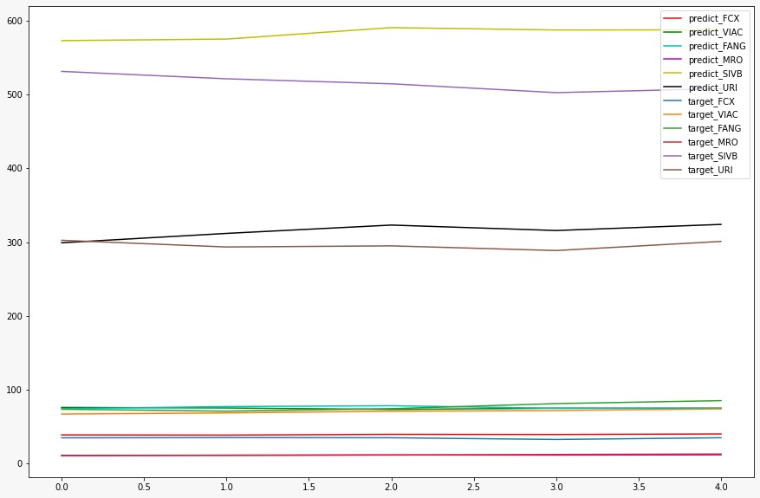
Results for LSTM
Test Data Top 10 Stocks for a Week
LSTM Model Training and Validation Loss (val_loss: 0.002)

Slide 21
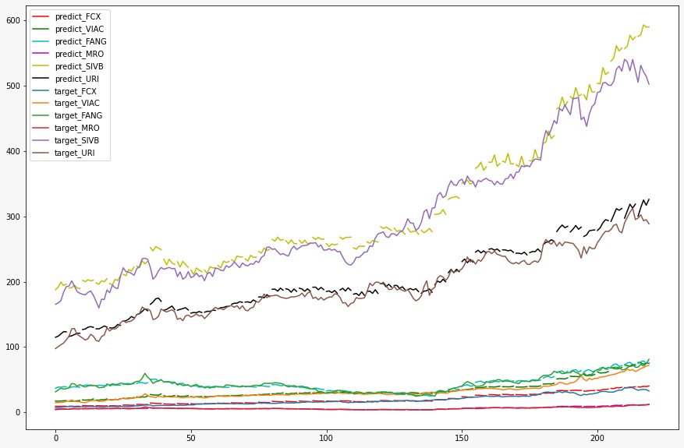
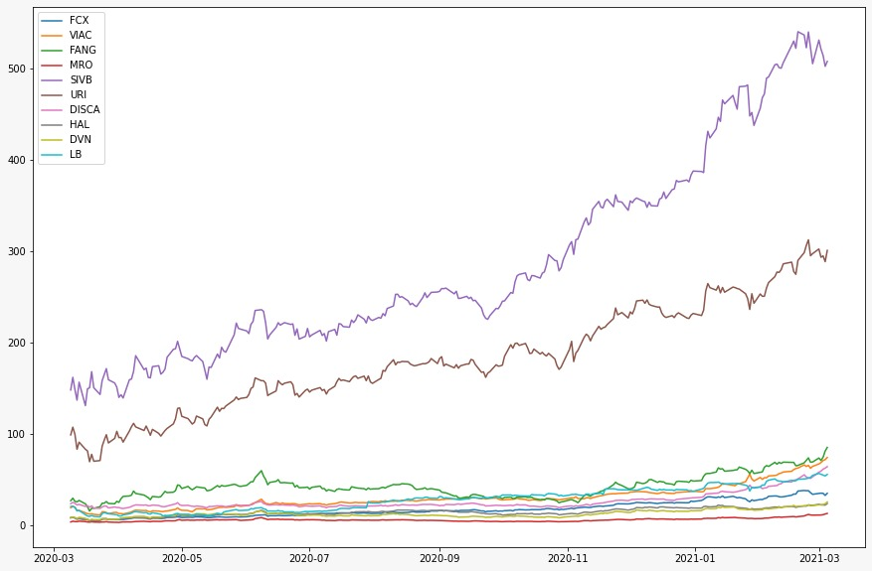
Test Data Top 5 Stocks for a Year
One year data of Top 10 Companies extracted from Yahoo finance

Slide 22
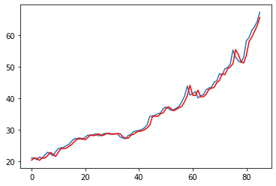
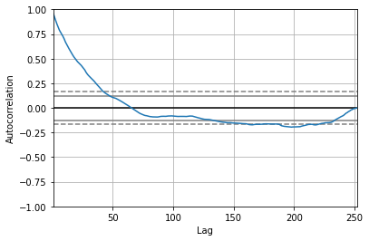
ARIMA Results for One Company
Mean Square Error

Slide 23

Sentiment Analysis

Slide 24

NEWS ANALYSIS
Libraries: Numpy, Pandas, TfidfVectorizer, BeautifulSoup, SentimentIntensityAnalyzer
Packages Used: Natural Language Toolkit , urllib, yahoo_fin, sklearn, bs4, wordcloud
Visualizations: WordCloud
Method: Vader

Slide 25

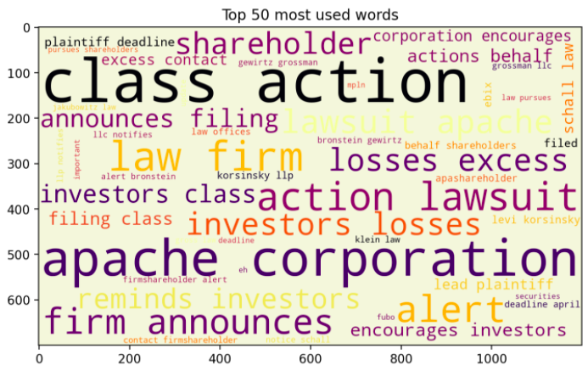
Wordcloud for Top 10 Stocks

Slide 26

Flowchart of steps
Same method to fetch and find Top 10 Companies
Fetching out news Headline from FinViz of Top 10 Stocks Fetched Earlier
START
Displayed Positive, Negative, Compound Score
Performed Sentiment Analysis Using Vader Method
Made some WordCloud for better Visualizations
END

Slide 27

Why Vader Method for social media sentiment analysis?
Vader Sentiment Analysis works better for with texts from social media and in general as well. It is based on lexicons of sentiment-related words. Each word in the lexicon is rated whether it is positive or negative.
It can very well understand the sentiment of a text containing emoticons, slangs, conjunctions, capital words, punctuations and much more.
Also, Textblob will ignore the words that it doesn’t know, it will consider words and phrases that it can assign polarity to and averages to get the final score.

Slide 28
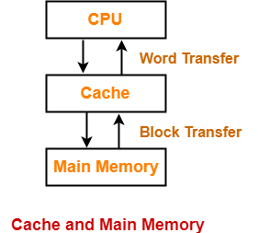
Improve app performance using cache
Streamlit provides a caching mechanism that allows our app to stay performant even when loading data from the web, manipulating large datasets, or performing expensive computations. This is done with the @st.cache decorator.
It tells Streamlit that whenever the function is called it needs to check a few things:
The input parameters that you called the function with
The value of any external variable used in the function
The body of the function
The body of any function used inside the cached function
If this is the first time Streamlit has seen these four components with these exact values and in this exact combination and order, it runs the function and stores the result in a local cache.
Then, next time the cached function is called, if none of these components changed, Streamlit will just skip executing the function altogether and, instead, return the output previously stored in the cache.

Slide 29
SWOT ANALYSIS
STRENGTHS
S
THREATS
Can predict stock prices of multiple companies at one go
Easy to use app to check the top stocks weekly
Reliable principles used for prediction of top 10 stocks.
Good data visualizations
Finscreener, yahoo finance and many other websites are quite advanced, smooth and faster.
Irregular economic conditions can lead to improper prediction of top 10 stocks.
T
W
WEAKNESSES
O
Not used fast database storage like SQLite
Website loading little slow
Inapplicability of Minervini principle in irregular economic conditions
OPPORTUNITIES
Deploy the app and publish it for public
Make app freely available to public so they can benefit

Slide 30

Future Work
Use SQLite for data storage so as to make fast data retrieval.
End to end automation can be done using task scheduler in Windows for running python script every Monday so as to get the weekly results
Add more interactive widgets to the App.
Deploy the App.

Slide 31
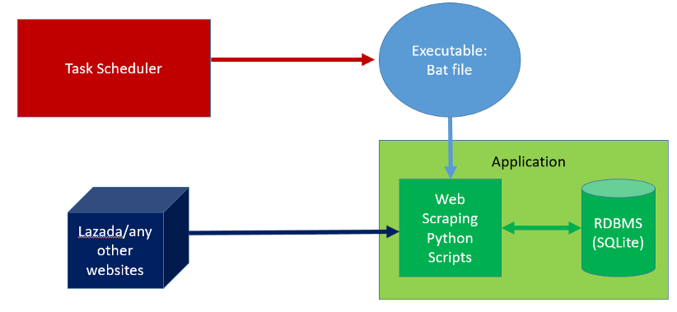
Automation
With Task Scheduler, we can run your Python script to execute periodic tasks every day/week/month/year depending on your needs.
Windows Task Scheduler is a default Windows Application to manage tasks in response of an event based or time based trigger.

Slide 32

Demo of the App

Slide 33
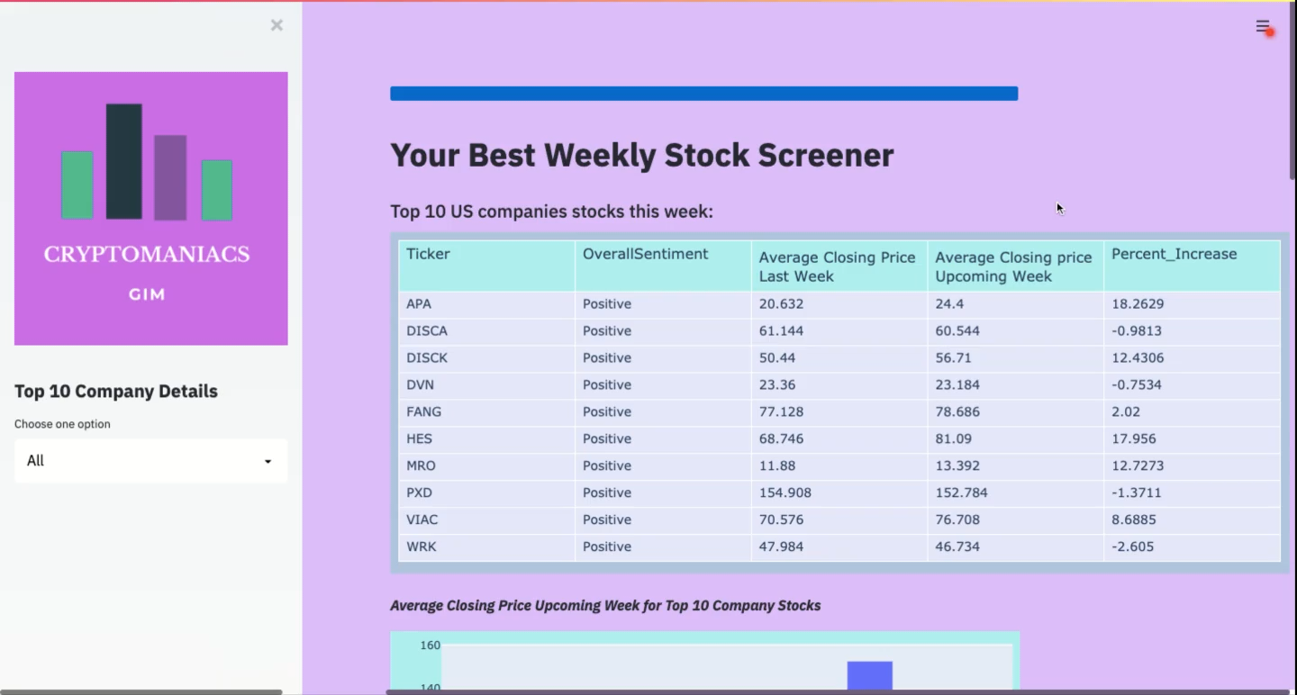

Slide 34

Conclusion
Stock investments have been of interest to many investors around the world. For successful investment, investors are keen to forecast the future situation of the stock market. Even small improvements of predictive efficiency can be very profitable.
Limitation of Automated Stock Prediction : There is no guarantee that the stock price prediction using historical data will be 100% accurate due to the uncertainty in the future
In addition to historical prices, other related information could also effect the stock prices such as politics, economic growth, financial news and the mood from social media.
Many studies have proven that the sentiment (mood) analysis has a high impact to the future prices. Thus, a mix of technical and fundamental as incorporated in our app can help in producing a high efficient prediction which can benefit in both personal and organizational level.

Slide 35
THANK YOU

